Slide 1
Introduction to Python

Slide 2

Guido van Rossum
Dutch Programmer
Inventor of Python

Slide 3
Introduction to Python
Python is a high-level programming language
Open source and community driven
“Batteries Included”
a standard distribution includes many modules
Dynamic typed
Source can be compiled or run just-in-time
Similar to perl, tcl, ruby

Slide 4
Why Python?
“Tried and true” language that has been in development since 1991
Can interface with the Component Object Model (COM) used by Windows
Can interface with Open Source GIS toolsets
Written in an “English” sort of format

Slide 5
Why not Visual Basic?
Visual Basic is still the method of configuring and customizing ArcMap
If you have a button on the toolbar, it’s VB
Python scripts can be placed in ArcToolbox
Python can be run from the command line without ArcMap or ArcCatalog being open
Using just the GIS Engine, lower overhead
Rapid prototyping, ease of authoring, etc.

Slide 6
Python Interfaces
IDLE – a cross-platform Python development environment
PythonWin – a Windows only interface to Python
Python Shell – running 'python' from the Command Line opens this interactive shell
For the exercises, we'll use IDLE, but you can try them all and pick a favorite

Slide 7
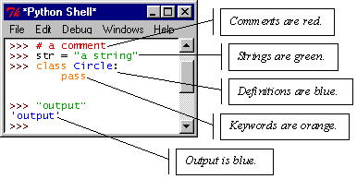
IDLE – Development Environment
IDLE helps you program in Python by:
color-coding your program code
debugging
auto-indent
interactive shell

Slide 8
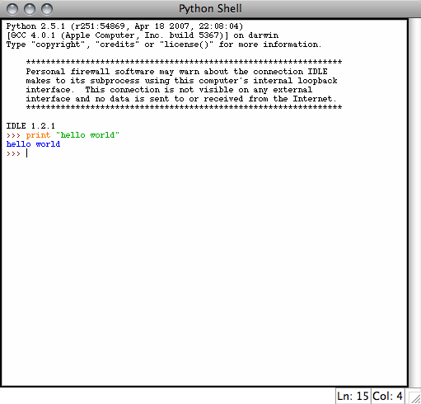
Example Python
Hello World
print “hello world”
Prints hello world to standard out
Open IDLE and try it out yourself
Follow along using IDLE

Slide 9
More than just printing
Python is an object oriented language
Practically everything can be treated as an object
“hello world” is a string
Strings, as objects, have methods that return the result of a function on the string

Slide 10
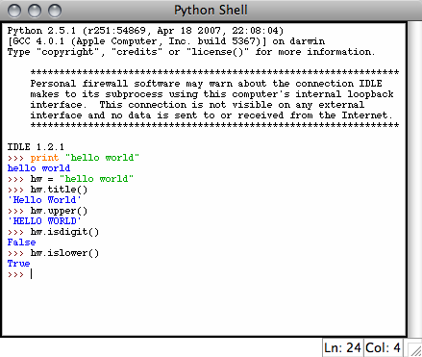
String Methods
Assign a string to a variable
In this case “hw”
hw.title()
hw.upper()
hw.isdigit()
hw.islower()

Slide 11
String Methods
The string held in your variable remains the same
The method returns an altered string
Changing the variable requires reassignment
hw = hw.upper()
hw now equals “HELLO WORLD”

Slide 12
Other Python Objects
Lists (mutable sets of strings)
var = [] # create list
var = [‘one’, 2, ‘three’, ‘banana’]
Tuples (immutable sets)
var = (‘one’, 2, ‘three’, ‘banana’)
Dictionaries (associative arrays or ‘hashes’)
var = {} # create dictionary
var = {‘lat’: 40.20547, ‘lon’: -74.76322}
var[‘lat’] = 40.2054
Each has its own set of methods

Slide 13
Lists
Think of a list as a stack of cards, on which your information is written
The information stays in the order you place it in until you modify that order
Methods return a string or subset of the list or modify the list to add or remove components
Written as var[index], index refers to order within set (think card number, starting at 0)
You can step through lists as part of a loop

Slide 14
List Methods
Adding to the List
var[n] = object
replaces n with object
var.append(object)
adds object to the end of the list
Removing from the List
var[n] = []
empties contents of card, but preserves order
var.remove(n)
removes card at n
var.pop(n)
removes n and returns its value

Slide 15
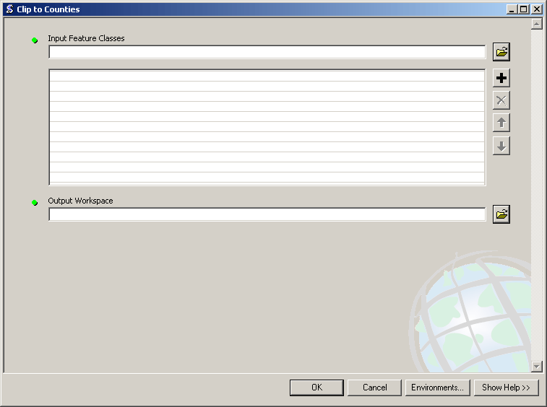
Lists in ArcToolbox
You will create lists:
Layers as inputs
Attributes to match
Arrays of objects
You will work with lists:
List of field names
List of selected features

Slide 16
Tuples
Like a list, tuples are iterable arrays of objects
Tuples are immutable – once created, unchangeable
To add or remove items, you must redeclare
Example uses of tuples
County Names
Land Use Codes
Ordered set of functions

Slide 17
Dictionaries
Dictionaries are sets of key & value pairs
Allows you to identify values by a descriptive name instead of order in a list
Keys are unordered unless explicitly sorted
Keys are unique:
var[‘item’] = “apple”
var[‘item’] = “banana”
print var[‘item’] prints just banana

Slide 18
Indentation and Blocks
Python uses whitespace and indents to denote blocks of code
Lines of code that begin a block end in a colon:
Lines within the code block are indented at the same level
To end a code block, remove the indentation
You'll want blocks of code that run only when certain conditions are met

Slide 19
Conditional Branching
if and else
if variable == condition: #do something based on v == c
else:
#do something based on v != c
elif allows for additional branching
if condition:
elif another condition:
…
else: #none of the above

Slide 20
Looping with For
For allows you to loop over a block of code a set number of times
For is great for manipulating lists:
a = ['cat', 'window', 'defenestrate'] for x in a: print x, len(x)
Results:
cat 3
window 6
defenestrate 12

Slide 21
Looping with For
We could use a for loop to perform geoprocessing tasks on each layer in a list
We could get a list of features in a feature class and loop over each, checking attributes
Anything in a sequence or list can be used in a For loop
Just be sure not to modify the list while looping

Slide 22
Modules
Modules are additional pieces of code that further extend Python’s functionality
A module typically has a specific function
additional math functions, databases, network…
Python comes with many useful modules
arcgisscripting is the module we will use to load ArcGIS toolbox functions into Python

Slide 23
Modules
Modules are accessed using import
import sys, os # imports two modules
Modules can have subsets of functions
os.path is a subset within os
Modules are then addressed by modulename.function()
sys.argv # list of arguments
filename = os.path.splitext("points.txt")
filename[1] # equals ".txt"

Slide 24
Files
Files are manipulated by creating a file object
f = open("points.txt", "r")
The file object then has new methods
print f.readline() # prints line from file
Files can be accessed to read or write
f = open("output.txt", "w")
f.write("Important Output!")
Files are iterable objects, like lists

Slide 25
Error Capture
Check for type assignment errors, items not in a list, etc.
Try & Except
try:
a block of code that might have an error
except: code to execute if an error occurs in "try"
Allows for graceful failure – important in ArcGIS

